Slide 1
vDocumentation An update
By @arielsanchezmor
V1.1

Slide 2
You can find this ppt in blogs.arielsanchezmora.com and your local VMUG forum
Or just ping @arielsanchezmor

Slide 3
A favor
Take a pic during this session. Tweet it out with #PAVMUG and #vDocumentation.
I really like interacting with people in Twitter and the #vCommunity – send me any questions you think of!

Slide 4
Agenda
A bit about vDocumentation
The VMworld 2017 presentation
What has happened since?
Let’s install it and try it out
Q&A and fun

Slide 5
Achieve maximum vSphere stability with PowerCLI assisted documentation: from buildout to daily administration
SER2077BU
Ariel Sanchez, Senior Technical Account Manager, VMware
Edgar Sanchez, Operating Systems Engineer IV, Convergys
#VMworld2017 #SER2077BU

Slide 6
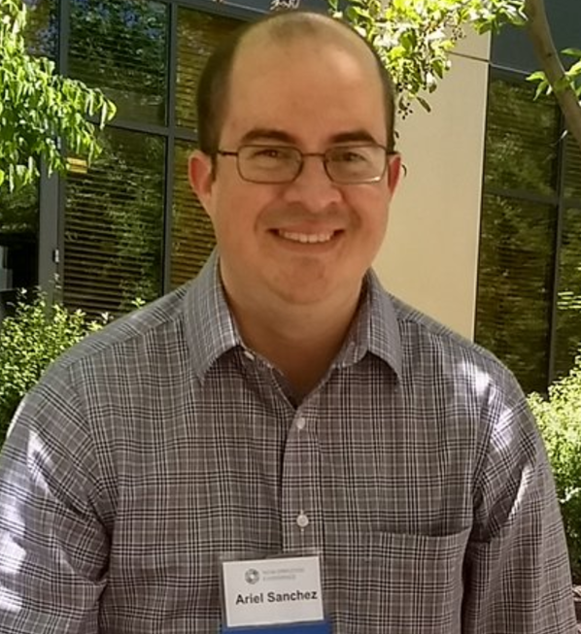

Presenter Introductions
The Sanchez brothers are not related!
Longtime co-workers and great friends
Ariel Sanchez Mora - @arielsanchezmor
Works for VMware - Senior Technical Account Manager
You can probably find him near the vBrownBag Community stage
Edgar Sanchez - @edmsanchez13
Works for Convergys – Operating Systems Engineer IV
You can find him at tonight’s Hackathon for Team 1, PCI

Slide 7
Admins who are very satisfied with their vSphere documentation
Low %
And, worse:
Most new-hires get this
reaction when they ask
where the documentation is!

Slide 8
Stability is the VM admin goal!
Core responsibility of VMware engineers is application availability!
VMware software & ecosystem allow tremendous flexibility and uptime, yet there is still:
Significant fire-fighting
Lack of confidence doing changes
Lack of consistent, repeatable processes
Avoidable downtime
Information hoarding
Overworked admins

Slide 9
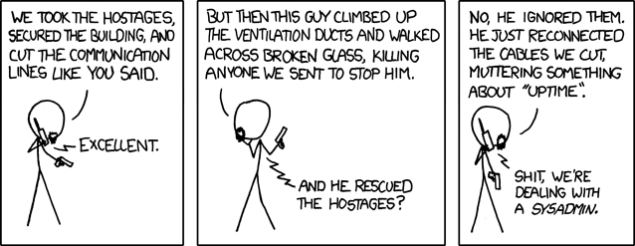
Make stability a primary focus
Stability doesn’t happen by accident
Uptime “hero numbers” myth
Opportunity for leadership
The most important influencers are here
Dedicate time and resources to stability
https://xkcd.com/705/

Slide 10
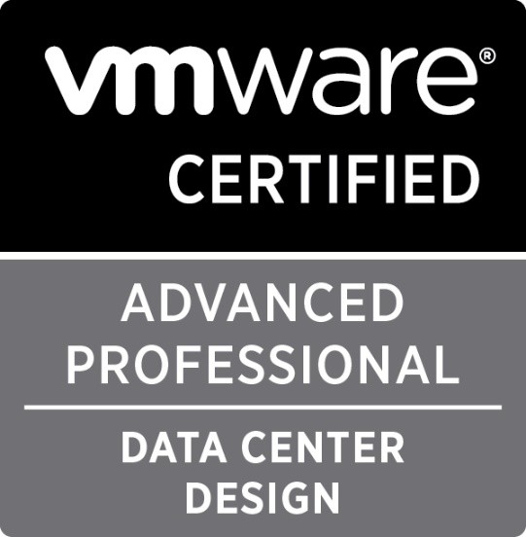

Invest in good design and enterprise components
Groom or hire VCAP Design / VCDX / Consultants / PSO
Reputable Hardware vendors part of the VMware ecosystem
HCL Validation before and after deployment
Enterprise software like VMware
Choose 3rd party vendors who invest and keep up to date
Follow VVD and Best Practices, and understand when not doing it is OK
Choose a release adoption rate

Slide 11
People and processes are more important over time
Lack of bandwidth = enemy of stability
Increased human mistakes
No real improvement in team
Engineers need time
Learn, think and discuss
Document and do knowledge transfer
Morale and employee churn
Engineers like “Wins”

Slide 12
Stability is at risk when making changes - plan properly!
Changes in the environment
Changes in the staff
Changes in software
Patching
Upgrading
Changes in Architecture
Comes back to engineer bandwidth

Slide 13
Being prepared for outages
Fast access to precise, relevant information
Response teams have process and access to resolve
Understand escalation levels
Understand support contracts
BC/DR planning and documentation

Slide 14
Build collaborative teams
When hiring and leading look for
Good communicators
Self-learners who like to share
Maturity and good manners
Clearly emphasize the team values
Documentation, standardization and clear processes
Peer-review, load-sharing, responsible time-off
Win as a team, not as individuals
Leaders: empower, provide direction and nurture

Slide 15
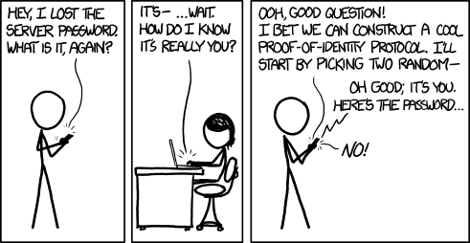
Importance of Documentation
https://xkcd.com/1121/

Slide 16
Company IT documentation
Organigram for all business units and for IT team
Repository of company locations, site names, addresses, IT contacts
Infrastructure Services
Subnetting, Routing, Firewalls
AD, DNS, NTP
Syslog
IT workflows – how to ask for help and submit changes
Vendor relationships and named contacts

Slide 17
vSphere documentation
Design documentation
Installation and hardening instructions and log
Patching instructions and log
Security standards and log
Grows and changes with time
Project tracking

Slide 18
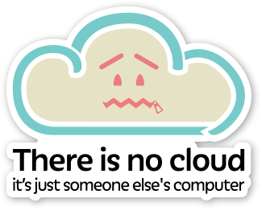
Doesn’t Cloud change this?
As long as you own “uptime”, your job includes documentation
What to document may change for many of us
Someone will still own documenting the hardware and hypervisor setup
Image by Chris Watterston

Slide 19
Can any of this be scripted?
Yes! Just about everything in vCenter and Host Client
You can create customized reports not available in vCenter
There are several free projects:
vCheck, a daily report in HTML to highlight possible issues (Alan Renouf)
RVTools, a very complete .Net application to gather data, identify and fix issues (Rob de Veij)
vCenter Documentation Script, outputs vCenter and Host info to Word/Text/HTML (Jake Rutski)
Truly you can build whatever you need using several SDK and APIs
Our favorite scripting tool is PowerCLI

Slide 20
PowerCLI and the vCommunity
“Good programmers know what to write. Great ones know what to rewrite (and reuse).” Eric S. Raymond

Slide 21
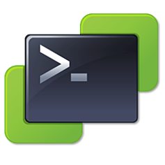
4.1 PowerCLI
Based on PowerShell
Easy to install and pickup
PowerCLI core available for Mac and Linux
Keeps getting improved and expanded
vSAN, SRM, Horizon, PowerNSX cmdlets
Great adoption by the vCommunity

Slide 22

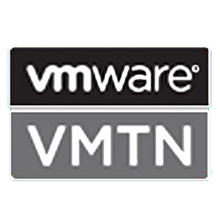
4.2 vCommunity makes PowerCLI easy
Huge thank you to the greats:
@alanrenouf
@LucD22
@lamw
@vBrianGraf
@kmruddy
@ChrisWahl
Many, many more
The thriving VMTN and VMware Code communities
All bloggers and admins who have shared their scripts
Spirit of sharing and building from each other

Slide 23
4.3 Presenting the vDocumentation scripts
PowerCLI commands to make vSphere documentation
ESXi Host Inventory with hardware and config details
ESXi I/O Devices detail with details such as firmware and driver versions
ESXi Networking details such as vSS, vDS, VMKernel config, CDP/LLDP
ESXi Storage details such as vmhba, WWN, iSCSI initiator, Datastores, Multi-Pathing
Open to the vCommunity for use and collaboration (MIT License)
Search vDocumentation in GitHub
Use #vDocumentation on Twitter
Part of a larger effort (free documentation templates)
Aim to create a vCommunity resource for vSphere environment documentation

Slide 24
4.4 Design goals
PowerShell and GitHub beginner friendly
Focus on ease of use
Simple and clear instructions
Simple installation
Simple defaults
Useful information to ensure stability
Excel output to be able to sort and filter report data as needed
Help users get value and support the project long term
Add to official PowerCLI example scripts
Use as a learning tool and be able to give back

Slide 25
We’re going to the GitHub README.MD page!

Slide 26
6.1 Hypervisor is the base for Cloud
Investments in operational stability are necessary
VMware ecosystem
VSAN
NSX
vRA
Horizon
SRM
Multi-cloud environments
Skills in documentation and scripting age very well

Slide 27
6.2 Documentation makes operations easier
Quickly assess the state of an environment with vDocumentation
Avoidable time sinks:
Tracing network ports when you need to add a new vlan
Confirming a host serial number to do hardware maintenance
Figuring out which password was used for a build 2 years ago
Checking driver/firmware versions across the environment
Providing server detail reports per location
And many more
“Work smarter not harder”

Slide 28
6.3 Our vision
vDocumentation was created to help the vCommunity
It needs more eyes, both coders & users, to improve!
Imagine our new-hire, asking for documentation, and hearing:
“We use the vDocumentation scripts"
Sighing with relief ☺

Slide 29
Some extra links
VMware Hardware Compatibility List for IO devices (use the 4 PCI Identifiers)
https://www.vmware.com/resources/compatibility/search.php?deviceCategory=io
How Edgar checks for Spectre/Meltdown
https://virtualcornerstone.com/2018/03/19/verify-new-spectre-mitigation-patches-using-powercli-and-vdocumentation/

Slide 30
Join VMware Code
Great place to interact with people using programming languages with VMware products
https://code.vmware.com/web/code/join
We have a #vDocumentation channel in there ☺

